Slide 1

H.R. S.M.A.R.T
Prompting Framework
A practical system for clearer, safer and more useful AI prompts in HR.
HR PROFESSIONALS
PRACTICAL
REPEATABLE
Role + Request + Context + Audience + Action + Format + Guardrails
Prepared for Vijay Perepa
Notes:
[Sources]
- Visual on this slide was generated with Microsoft Copilot.
[/Sources]

Slide 2

WHY IT MATTERS
Better prompts turn AI into a reliable HR co-pilot
Structure reduces ambiguity and makes outputs easier to review, reuse and improve.
01
Clarity
Replace vague requests with explicit outcomes.
02
Consistency
Standardize how HR teams ask for repeatable work.
03
Control
Set audience, format, tone and boundaries up front.
04
Quality
Create stronger first drafts that remain human-reviewed.
Notes:
[Sources]
- Visual on this slide was generated with Microsoft Copilot. Framework benefits are presentation guidance based on the H.R. S.M.A.R.T model in this conversation.
[/Sources]

Slide 3
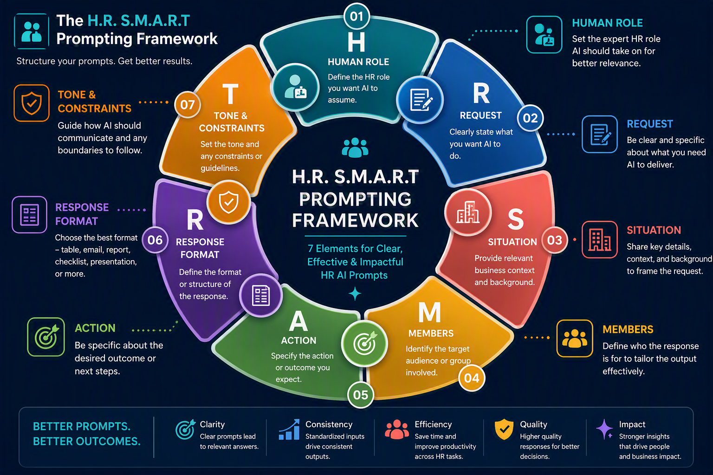
The seven-part framework at a glance
Use every element for high-stakes HR work. Use the smallest useful subset for quick tasks.
Notes:
[Sources]
- Visual on this slide was generated with Microsoft Copilot.
[/Sources]

Slide 4
BUILD THE BRIEF
Start with role, request, context and audience
These four elements tell AI who it is, what to do, why it matters and who the result serves.
01
02
H
Human Role
R
Request
Assign the HR expertise or perspective AI should adopt.
State the exact task, decision or deliverable required.
03
04
S
Situation
M
Members
Provide business context, background and relevant facts.
Name the audience, employee group or stakeholders.
Tip: Use only job-relevant, necessary data. Remove names and sensitive details when they are not required.
Notes:
[Sources]
- Framework content developed from the H.R. S.M.A.R.T model provided in this conversation.
[/Sources]

Slide 5
SHAPE THE OUTPUT
Define action, format and guardrails
The final three elements convert context into a usable, reviewable HR deliverable.
05
06
07
A
Action
R
Response Format
T
Tone & Constraints
Specify the outcome, decisions, recommendations or next steps.
Choose a table, email, report, checklist, FAQ, agenda or slides.
Set tone, length, policy boundaries and review requirements.
A strong HR prompt does not ask AI to make the final people decision.
It asks AI to support drafting, summarization, analysis, options and preparation, while a qualified human reviews the result.
Notes:
[Sources]
- Framework content developed from the H.R. S.M.A.R.T model provided in this conversation.
[/Sources]

Slide 6
REUSABLE PROMPT TEMPLATE
Copy, customize and run
A compact template for recruitment, L&D, communications, policy drafting and workforce planning.
Suggested roles
Act as a [HR role].
Recruitment
Talent Acquisition Specialist
Situation: [business context and known facts]
Learning
L&D Manager
Audience: [target members or stakeholders]
Task: [specific request and desired action]
Employee Relations
HR Business Partner
Output format: [email / table / report / plan / FAQ]
Analytics
HR Data Analyst
Constraints: [tone, length, policy, privacy, review needs]
Policy
HR Compliance Expert
Notes:
[Sources]
- Framework content developed from the H.R. S.M.A.R.T model provided in this conversation.
[/Sources]

Slide 7

WORKED EXAMPLE
Microsoft Copilot adoption communication plan
See how each framework element contributes to a complete HR prompt.
H
Senior HR Business Partner
Change management expertise
R
Create an adoption plan
Clear deliverable
S
1,000 employees; mixed AI familiarity
Useful context
M
Executives, managers, employees
Audience segments
A
90-day plan, messages, KPIs, risks
Explicit outputs
R
Summary, roadmap and matrices
Usable format
T
Professional, simple, measurable
Tone and limits
Notes:
[Sources]
- Visual on this slide was generated with Microsoft Copilot. Example content is based on the worked scenario provided in this conversation.
[/Sources]

Slide 8
APPLY IT ACROSS THE HR LIFECYCLE
One framework, many workflows
Keep the method consistent while changing the role, situation, action and format.
Recruitment
Job descriptions • interview guides • candidate communications
Onboarding
Welcome plans • FAQs • role-based learning journeys
L&D
Training agendas • exercises • assessments • follow-up
Employee Comms
Announcements • manager toolkits • change campaigns
HR Analytics
KPI definitions • insight summaries • question lists
Policies
First drafts • simplification • FAQs • version comparison
Human review remains essential for accuracy, fairness, privacy and policy alignment.
Notes:
[Sources]
- Framework content developed from the H.R. S.M.A.R.T model provided in this conversation.
[/Sources]

Slide 9
Before you send the prompt
A 60-second quality check for HR professionals
✓
Is the HR role appropriate?
✓
Is the output format usable?
✓
Is the request specific and actionable?
✓
Are tone and boundaries stated?
✓
Did I provide only necessary context?
✓
Will a qualified human review the result?
✓
Is the audience clearly identified?
H + R + S + M + A + R + T → Clearer prompts. Better HR outcomes.
Notes:
[Sources]
- Framework content developed from the H.R. S.M.A.R.T model provided in this conversation.
[/Sources]

